Slide 1
HUAWEI-NUS Innovation Challenge
Solution Presentation
April 9th 2023
Sultans of Trade
Manan Lohia
Muthukumaran S/O Samiayyan
Pragati Sangal
Prasanna Govindarajan
Kaushik Asok
Jung Hyun Park

Slide 2






Team members
Manan Lohia
Pragati Sangal
Kaushik Asok
Muthukumaran S/O Samiayyan
Prasanna Govindarajan
Jung Hyun Park

Slide 3
1. Introduction
Objectives of the Stock Prediction Model
2. Architecture - Cloud Service
Huawei Cloud
3. Data Preprocessing
Label for Model Training
Label Generation Techniques
4. Feature Engineering
Overview of Feature Engineering
Feature Engineering Pipeline
Example Features

Slide 4
5. Modelling
Selected Model
Model Training
Model Outcomes
6. Evaluation
Performance Metrics
7. Strategy
Overview of the Strategy
Strategy in Depth
Buy & Sell
Cut-off Time

Slide 5
8. Lessons and Challenges in Implementation
9. Conclusion
Learnings
Possible Enhancements

Slide 6
1. Introduction

Slide 7
Objectives of the Stock Prediction Model
To create the optimal stock timing model
that finds the best trading opportunity
while providing the lowest
overall trading cost of the stock
Buy Low, Sell High

Slide 8
2. Architecture - Cloud Service

Slide 9
Huawei Cloud
Service | Usage
Huawei Object Storage Service (OBS) – Standard Storage | Top layer storage containing raw data, transformed data and output data, including model and other files generated during training
ModelArts Notebook (Image - pytorch1.8-cuda10.2-cudnn7-ubuntu18.04) | Computing environment to prototype and develop model. Jupyter Notebook and terminal were the predominantly used tools to manage libraries, transform data and train model
Elastic Volume Service (EVS) | Temporary storage for notebook. Raw data, transformed data and output files were copied from and into OBS using the moxxing library
Model Arts Custom Training Job | Custom training jobs were attempted to streamline model training, however we were unable to debug environment issues in the pre-built image

Slide 10
3. Data Preprocessing

Slide 11
Label for Model Training
It is to create a target variable for the model training.
The main label to train our model is determined by local minima
A local minimum is a point in the time series where the price of an asset is at its lowest point in a given interval of time.
This label is important for identifying potential buy signals looking to buy an asset at a low point in its price trajectory.

Slide 12
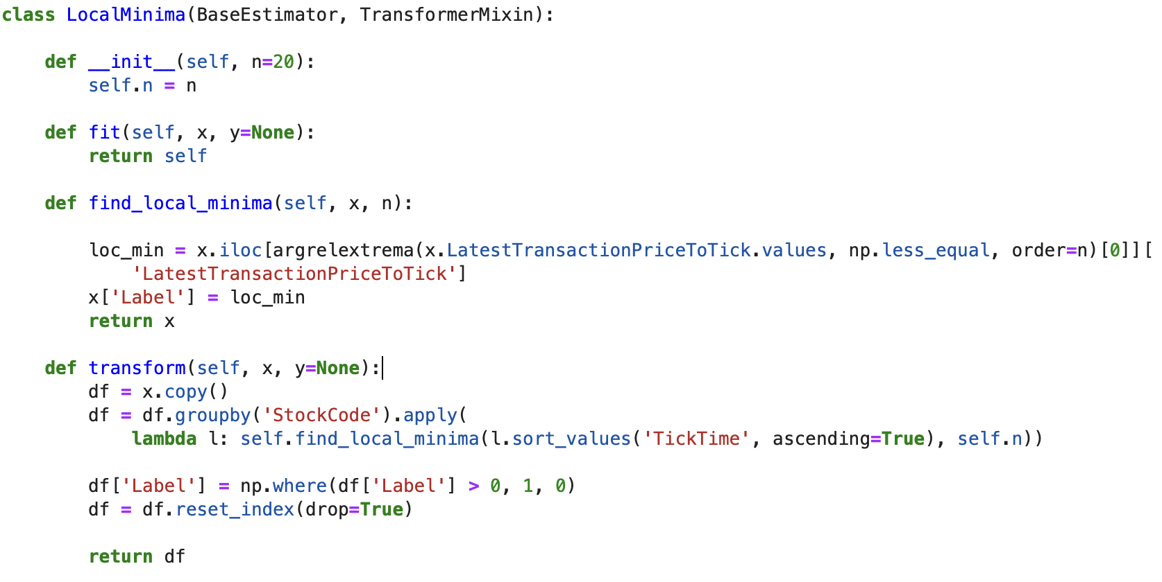
Label Generation Techniques – Local Minima

Slide 13
Our Local Minima Label class implements the SciPy library's argrelextrema function to identify local minima in the ‘LatestTransactionPriceToTick’ column of our dataset.
The class groups the data by ‘StockCode’ and applies the argrelextrema function to each group to identify local minima for that specific stock.
The resulting labels are binary values, with 1 indicating that the price is at a local minimum and 0 indicating otherwise.
Label Generation Techniques – Local Minima

Slide 14
4. Feature Engineering

Slide 15
Overview of Feature Engineering
Feature engineering is the process of creating new features that capture meaningful patterns or relationships in the data.
Thus, Feature engineering is a critical step in building effective machine learning models.
Our pipeline of custom features complements the original features provided by the competition and enhances the information in our data.
These features enable our models to capture meaningful patterns and relationships in the price and volume dynamics of the financial instruments we are analyzing.

Slide 16
Feature Engineering Pipeline
Our pipeline consists of several custom transformers that perform specific operations on the data
These operations include:
Ratio limits
Weighted average commission price spread
Latest transaction price to tick difference (shifted)
Spread
Rolling commission price spread means (5, 10, 15, 25, 50, 100)
Rolling transaction price means (5, 10, 15, 25, 50, 100)
Transaction volume
Rolling commission price spread mean differences (5, 10, 15, 25, 50, 100)
Rolling transaction price mean differences (5, 10, 15, 25, 50, 100)
N-day regression (5, 10, 15, 25, 50)
By applying these transformations to the raw tick data, we can extract meaningful features that capture the underlying patterns and trends in the data, and use them to train accurate machine learning models.

Slide 17
Example Feature: N-day Regression
N-day regression calculates the slope of a linear regression line over a rolling window of n days
for a given stock
This feature captures the trend and direction of the price movement over time, allowing the model to better predict future price movements.
We generate N-day regression features for various window sizes (5, 10, 15, 25, 50)

Slide 18
More Example Features
LatestTransactionPriceToTickDiffShift1: Calculates the difference between the latest transaction price and the tick price from the previous tick.
RollingTransPriceMeanDiff: Calculates the difference between the rolling mean of the transaction price for different windows.

Slide 19
5. Modelling

Slide 20
Selected Model
XGBoost
particularly useful for solving classification and regression problems on structured or tabular data
works by combining multiple decision trees to make predictions
often considered the state-of-the-art algorithm for tabular data, and is widely used in industry and academia for a variety of tasks.

Slide 21
Selected Model – Side Note
To make our strategy more sophisticated, we have utilized the model as an aiding tool as part of our buy-and-sell strategy.
The outcome of the model will be combined with other strategies to generate more precise buy-and-sell predictions.

Slide 22
Model Training Strategy
For initial test,
Only one stock ‘600536.SH’ from Dec 29, 2022 was used
For the model training,
The entire stock in the tick data from Dec 30, 2022 (tickdata_20221230.csv) was used

Slide 23
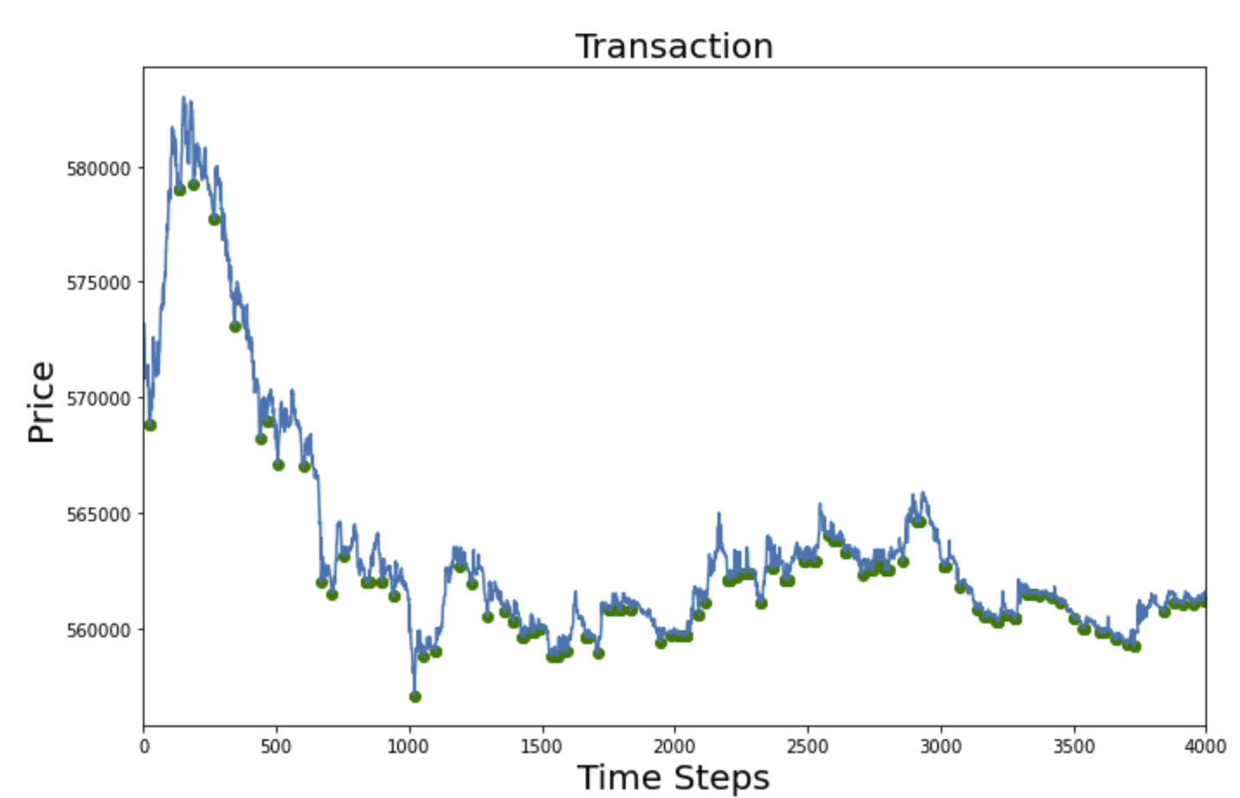
Model Outcomes
For our strategy, finding local minima is crucial
The model tries to identify local minima
(green points)

Slide 24
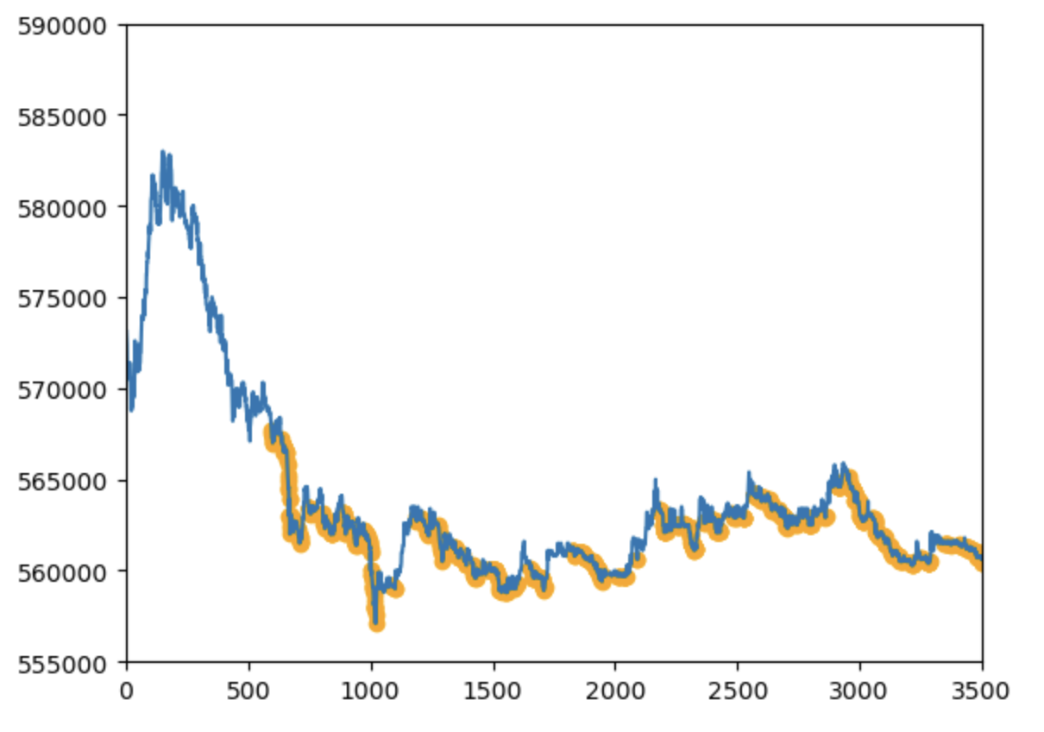
Model Outcomes
Transaction Price
The model effectively catches the downward trends in transaction prices
(highlighted in orange)
Buying decisions are within the downward trends
Data Point Index

Slide 25
6. Model Evaluation

Slide 26
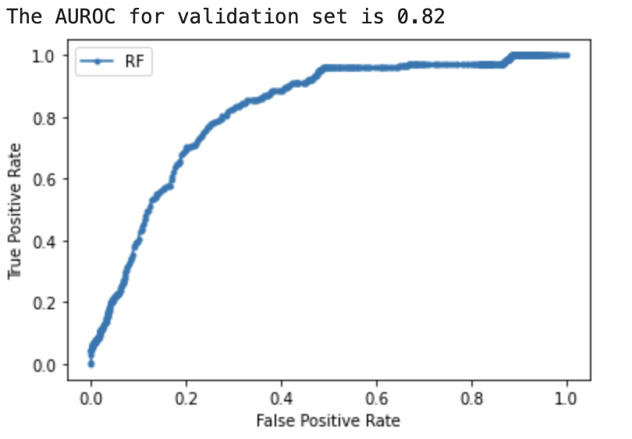
Performance Metrics - AUROC
A higher AUROC score would indicate better performance in correctly identifying true positives and minimizing false positives and false negatives.
The AUROC score of 0.82 on the validation set indicates that the model has good performance in distinguishing between the positive and negative classes on the validation data.

Slide 27
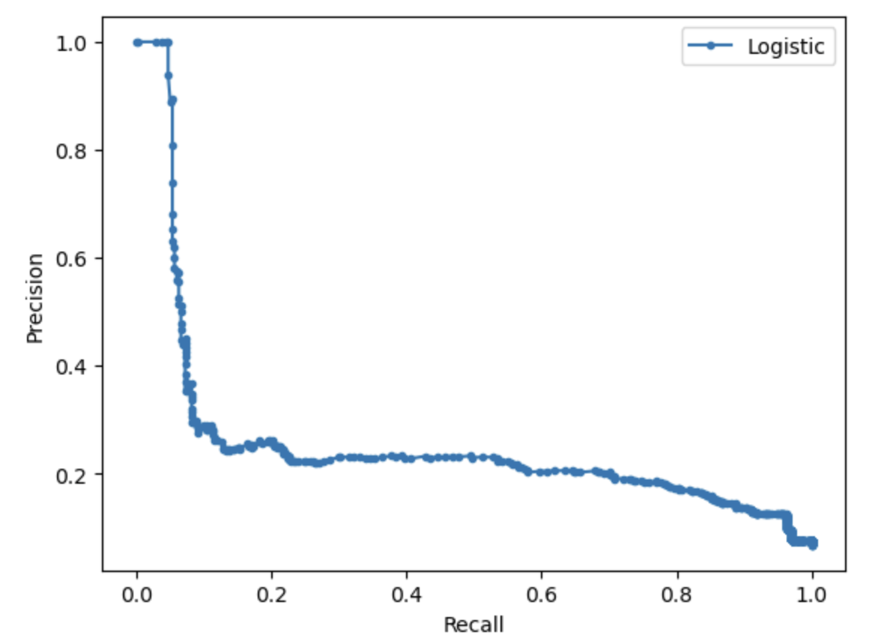
Performance Metrics - Precision & Recall Curve
Precision-Recall (PR) curve is a graph that visualizes the trade-off between precision and recall for different threshold values in a binary classification problem.
The AUPRC value of 0.253 for our validation set means that the model has moderate performance in correctly identifying positive instances with high confidence.

Slide 28
7. Strategy

Slide 29
Overview of the Strategy
Buy & Sell
Strategy
Implemented from 14:15:00 to 14:35:00
Cut-off Time
Strategy

Slide 30
Overview of the Strategy
We used a trading strategy that buys and sells shares based on certain conditions.
The strategy code loops through the preprocessed and predicted data.
Buy & Sell
Strategy
Cut-off Time
Strategy

Slide 31
Strategy in Depth – Buy & Sell
The model provides useful
buy-shares signals according
to the downward trends
(shown in orange highlights)
that the model pick up.
2. Moving averages thresholds, combined with the model predictions, are deployed to further enhance the strategy.

Slide 32
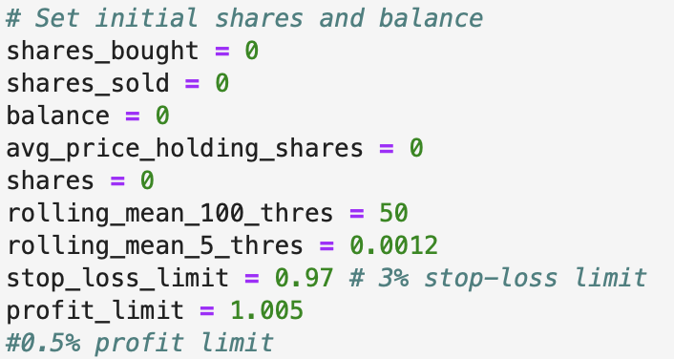
Strategy in Depth – Buy & Sell (Initialization of Variables)

Slide 33
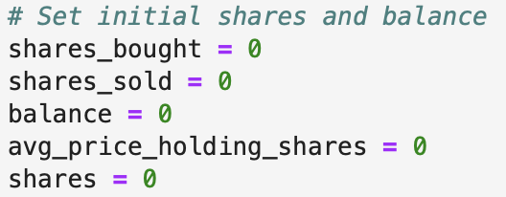
Strategy in Depth – Buy & Sell (Initialization of Variables)
The initial shares bought are 0, and thus, the balance also reflects 0.
Therefore, we will buy shares first and then be able to sell them (no short-selling).
The balance (of shares) will be updated after buy-and-sell transactions occur.

Slide 34
Strategy in Depth – Buy & Sell
For each row in the tick data, the code checks whether it is possible to buy 10 shares based on certain conditions such as the rolling mean difference and the predicted buy signal from the model.
If the conditions are met, 10 shares are bought at the current price and the average price of holding shares is updated accordingly.

Slide 35
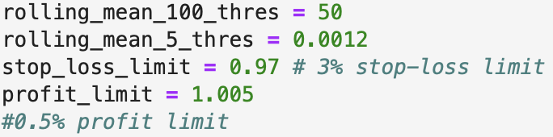
Strategy in Depth – Buy & Sell (Conditions)
Buy condition: The strategy will buy 10 shares of a stock if the following conditions are met:
The rolling mean difference of the latest transaction price to the tick over the past 5 ticks is greater than a threshold value multiplied by the latest transaction price to the tick. This threshold is set at 0.0012 (to ensure that different thresholds are implemented for different stocks)
The rolling mean difference of the latest transaction price to the tick over the past 100 ticks is greater than a threshold value. This threshold is set at 50.
The predicted buy signal from the XGBoost model is positive.
Sell condition: The strategy will sell 10 shares of a stock if the following conditions are met:
The latest transaction price is greater than or equal to a profit limit of 1.005 times the average price of holding shares, OR the latest transaction price is less than or equal to a stop-loss limit of 0.97 times the average price of holding shares.

Slide 36
Strategy in Depth – Cut-off Time
This second part of the strategy is designed in a way that further minimizes the loss by dumping or purchasing of shares to meet the requirements of the competition, in terms of the maximum buy-or-sell volume.
It is executed only during the time frame of 14:15:00 to 14:35:00.

Slide 37
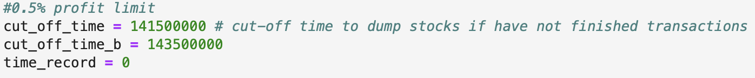
Strategy in Depth – Cut-off Time
Rebuy condition: The strategy will buy an additional 10 shares of a stock at a time if the following conditions are met:
The latest transaction time is past a certain cut-off time (set at 14:15).
The strategy has not yet bought 100 shares of the stock.
Check-and-Dump condition: The strategy will sell 10 shares of a stock at a time if the following conditions are met:
The latest transaction time is past a certain cut-off time (set at 14:35).
The strategy has bought 100 shares of the stock but has not yet sold 100 shares.
The latest transaction price is higher than the average price of holding shares.
Final Dump condition: The strategy will be implemented after 14:35:00 if we have not sold all 100 shares. We can sell 10 shares at a time without any constraint to meet the selling of 100 shares by the end of the day.

Slide 38
8. Lessons &
Challenges in Implementation

Slide 39
Lessons & Challenges in Implementation
Running the pipeline at scale – It took almost three hours to process and train the model for a single tickdata file.
Explore using distributed frameworks such as spark to process and train the data faster.
Also explore using other frameworks, such as Dask, distributed XGBoost or Neural Networks on GPU to accelerate development
Deploying the correct environment for execution of the strategy – We faced challenges when attempting to recreate the development environment on the competition server.
Using containerized services such as docker to act as an intermediary can help maintain a predictable execution environment

Slide 40
Lessons & Challenges in Implementation
Testing and Evaluation of Strategy – Evaluation was done on a single stock on a local system due to time constraints and scaling issues
Use functions and pipelines to simplify testing of a strategy to give flexibility to test multiple strategies
Implement distributed frameworks to accelerate processing time

Slide 41
9. Conclusion

Slide 42
Learnings
Participating in the Innovation Challenge helped us foray into the world of algorithmic trading and understand the complexities involved in identifying, developing and deploying efficient strategies to meet business requirements
We were also able to avail this opportunity to learn about using a cloud environment to work with data, and how to leverage the services to develop architecture to convert raw data into actionable insights using principles of Data Engineering and DevOps

Slide 43
Possible Enhancements
Augment given data with additional datasets such as web scraping to receive live updates on the company and assess public sentiment to predict intraday movements in price
Use more technical indicators, such as momentum, MACD, RSI etc. as additional features
Use XAI/MLI to identify the most important features and develop a lighter model using subset of the data
Assess models of different complexity to back-test the strategies

